Slide 1
CS-2001 Data Structures
Graph
Week 15 & 16| Lecture 41-45

Slide 2
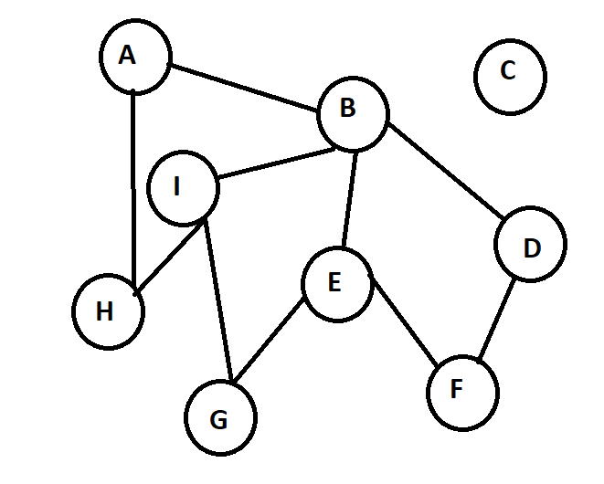
Graphs
A graph is a set of pair – (V, E), where V is the set of vertices and E is the set of edges, connecting the pairs of vertices. A Graph is a non-linear data structure consisting of nodes and edges.
Set of nodes are A,B,C,D,E,F,G,H,I
Nodes A&H are connected through Edge

Slide 3
Graphs vs Trees
Trees | Graphs
Only one path/edge between two nodes. | Multiple paths/edges/links between two nodes.
Has a Root Node. | No Root Node.
Dont have loops. | Can Have loops.
Have N-1 edges (N = No of nodes) | No of edges not defined.
Hierarchical Model | Network Model.

Slide 4
Graph Terms & Properties
Adjacency − Two node or vertices are adjacent if they are connected to each other through an edge. In the following example, B is adjacent to A, C is adjacent to B, and so on.
Path − Path represents a sequence of edges between the two vertices. In the following example, ABCD represents a path from A to D.
Self-Loop − Is an edge that connects a vertex to itself. A simple graph contains no loops.
Multi Edge − two or more edges that are connecting to the same two vertices.
Simple Graph − Graphs without loops or parallel edges are called simple graphs.
The degree of a node − The degree of a node is the no of edges incident/attached on it.
Path − A path can be defined as the sequence of nodes that are followed in order to reach some terminal node E from the initial node A.
Simple Path − A path is a Simple path if no vertices(and thus edges) are not repeated
Cycle − A cycle can be defined as the path which has no repeated edges or vertices except the first and last vertices.

Slide 5
Graph Types
Weighted Graph:- will contains weight on each edge where as unweighted does not. A weight is a numerical value attached to each individual edge in the graph. Directed (Digraph):- A directed graph is a set of vertices (nodes) connected by edges, with each node having a direction associated with it. Edges are usually represented by arrows pointing in the direction the graph can be traversed.
Undirected Graphs:- In an undirected graph the edges are bidirectional, with no direction associated with them. Hence, the graph can be traversed in either direction. The absence of an arrow tells us that the graph is undirected.
Trivial Graph:- A graph G= (V, E) is trivial if it contains only a single vertex and no edges.
Simple Graph:- If each pair of nodes or vertices in a graph G=(V, E) has only one edge, it is a simple graph. As a result, there is just one edge linking two vertices, depicting one-to-one interactions between two elements.
Multi Graph:- If there are numerous edges between a pair of vertices in a graph G= (V, E), the graph is referred to as a multigraph. There are no self-loops in a Multigraph.
Null Graph:- It's a reworked version of a trivial graph. If several vertices but no edges connect them, a graph G= (V, E) is a null graph
Complete Graph:- If a graph G= (V, E) is also a simple graph, it is complete. Using the edges, with n number of vertices must be connected. It's also known as a full graph because each vertex's degree must be n-1.
Pseudo Graph:- If a graph G= (V, E) contains a self-loop besides other edges, it is a pseudograph.
Regular Graph:- If a graph G= (V, E) is a simple graph with the same degree at each vertex, it is a regular graph. As a result, every whole graph is a regular graph.
Connected Graph:- If there is a path between one vertex of a graph data structure and any other vertex, the graph is connected.
Disconnected Graph:- When there is no edge linking the vertices, you refer to the null graph as a disconnected graph.
Cyclic Graph:- If a graph contains at least one graph cycle, it is considered to be cyclic.
Acyclic Graph:- When there are no cycles in a graph, it is called an acyclic graph.

Slide 6
Graph Applications
Dijkstra’s Algorithm
Prims’s Algorithm
Kruskal’s Algorithm
Graphs are used to define the flow of computation.
Graphs are used to represent networks of communication.
Graphs are used to represent data organization.
Graph theory is used to find shortest path in road or a network.
In Google Maps, various locations are represented as vertices or nodes and the roads are represented as edges and graph theory is used to find the shortest path between two nodes.

Slide 7
Graph Implementation Adjacency Matrix
When it comes to implementation of Graph DS in Computer Applications Adjacency Matrix & Adjacency List are the most commonly used representations of a graph –
An adjacency matrix is a way of representing a graph as a matrix of booleans (0’s and 1’s). A finite graph can be represented in the form of a square matrix on a computer, where the boolean value of the matrix indicates if there is a direct path between two vertices.
Let’s assume the n x n matrix as adj[n][n].
if there is an edge from vertex i to j, mark adj[i][j] as 1. i.e. adj[i][j] == 1 if there is no edge from vertex i to j, mark adj[i][j] as 0. i.e. adj[i][j] == 0
Pros: Representation is easier to implement and follow. Removing an edge takes O(1) time. Queries like whether there is an edge from vertex ‘u’ to vertex ‘v’ are efficient and can be done O(1). Cons: Consumes more space O(V^2). Even if the graph is sparse(contains less number of edges), it consumes the same space. Adding a vertex is O(V^2) time.

Slide 8
Graph Implementation Adjacency Matrix
Ardency matrix implementation of graph is preferred only when the graph is dense and number of nodes are relatively less then edges.
Time Complexity
Find Node in Graph O(N)/O(1)
Find All Adjacent Node O(N)
Check if two nodes connected O(1)
Space Complexity
O(N²)
A | B | C | D | E | F | G | H | I
0 | 1 | 0 | 0 | 0 | 0 | 0 | 1 | 0
1 | 0 | 0 | 1 | 1 | 0 | 0 | 0 | 1
0 | 0 | 0 | 0 | 0 | 0 | 0 | 0 | 0
0 | 1 | 0 | 0 | 0 | 1 | 0 | 0 | 0
0 | 1 | 0 | 0 | 0 | 1 | 1 | 0 | 0
0 | 0 | 0 | 1 | 1 | 0 | 0 | 0 | 0
0 | 0 | 0 | 0 | 1 | 0 | 0 | 0 | 1
1 | 0 | 0 | 0 | 0 | 0 | 0 | 0 | 1
0 | 1 | 0 | 0 | 0 | 0 | 1 | 1 | 0
A
B
C
D
E
F
G
H
I

Slide 9
Graph Implementation Adjacency List
An array of lists is used. The size of the array is equal to the number of vertices. Let the array be an array[]. An entry array[i] represents the list of vertices adjacent to the ith vertex. This representation can also be used to represent a weighted graph. The weights of edges can be represented as lists of pairs. Adjacency lists are not well suited for parallelism since the lists require that we traverse the neighbors of a vertex sequentially.
Time Complexity
Find Node in Graph O(N)
Find All Adjacent Node O(N)
Space Complexity
O(no of Edges)
A | H | I
B | A | D | I | H
C
D | F | B
E | F | G | B
F | D | E
G | I | E
H | I | A
I | B | I | H

Slide 10
Graphs Operations
Add Vertex
Update Vertex
Delete Vertex
Add Edge
Update Edge
Delete Edge
Check if 2 Vertices are Neighbors
Search Vertex
Print All Neighbors of a Vertex
Print Graph

Slide 11
Graphs Working with code
Edge Class
Int DestinationVertexID
int weight
Vertex Class
Int state_id;
string state_name;
List <Edge>edgeList;
Graph Class -
vector<Vertex> vertices;
DestinationVertexID | weight
state id | state name
state_id | state_name
state_id | state_name
state_id | state_name

Slide 12
Graph Add Vertex Operation
function addVertex(newVertex)
{
check = checklfVertexExistByID(vid)
if check==true
then->print("Vertex Already Exist")
else
vertices.push_back(newVertex)
print("Vertex Added")
}
function checklfVertexExistByID(vid)
{
loop:(int i=0 to vertices.size)
if(vertices.at(i)==vid)
return true
end loop
return false
}

Slide 13
Graph Add Edge Operation
function addEdgeByID(id1,id2,w)
{
check1= checklfVertexExistByID(id1)
check2= checklfVertexExistByID(id2)
IF check1 && check2== TRUE
then → check3= checklfEdgeExistByID(id1,id2)
IF check3== true
then → print("EDGE already Exist")
ELSE
LOOP: i=0 to vertices.size
IF (vertices.at(i).getStateID() == from Vertex)
Edge e(toVertex, w) vertices.at(i).edgeList.push_back(e)
ELSE IF (vertices.at(i).getStateID() == toVertex)
Edge e(from Vertex, w)
vertices.at(i).edgeList.push_back(e)
END LOOP
print ("Edge Added Successfully") }
}
function checklfEdgeExistByID(id1, id2){ Vertex v = getVertexByID(id1)
list <Edge> e
e=v.getEdgeList()
LOOP: auto it = e.start to e.end
IF it->getDestinationVertex() == id2 THEN return true END LOOP
return false
}
function getVertexByID(vid) {
Vertex temp
LOOP: i=0 to vertices.size
temp = vertices.at(i)
IF temp.getStateID()==vid
return temp
END LOOP
}

Slide 14
Graph Update Edge Operation
updateEdgeByID(from Vertex, toVertex, newWeight) {
check = checklfEdgeExistByID(from Vertex, toVertex)
IF check == TRUE then →
LOOP: 0 to vertices.size
{
IF vertices.at(i).getStateID() == from Vertex THEN →
LOOP: it = vertices.at(i).edgeList.begin() TO vertices.at(i).edgeList.end()
IF it->getDestinationVertexID() == toVertex THEN→
it->setWeight(new Weight)
break
ELSE IF vertices.at(i).getStateID() == toVertex THEN →
LOOP: it = vertices.at(i).edgeList.begin() TO vertices.at(i).edgeList.end()
IF it ->getDestinationVertexID() == fromVertex THEN -->
it->setWeight(newWeight)
}
break print("Edge Weight Updated Successfully")
Else
print("Edge between from Vertex & toVertex does not exist")
}

Slide 15
Graph Delete Edge Operation
updateEdgeByID(from Vertex, toVertex, newWeight) {
check = checklfEdgeExistByID(from Vertex, toVertex)
IF check == TRUE then →
LOOP: 0 to vertices.size
{
IF vertices.at(i).getStateID() == from Vertex THEN →
LOOP: it = vertices.at(i).edgeList.begin() TO vertices.at(i).edgeList.end()
IF it->getDestinationVertexID() == toVertex THEN→
vertices.at(i).edgeList.erase(it)
break
ELSE IF vertices.at(i).getStateID() == toVertex THEN →
LOOP: it = vertices.at(i).edgeList.begin() TO vertices.at(i).edgeList.end()
IF it ->getDestinationVertexID() == fromVertex THEN -->
vertices.at(i).edgeList.erase(it)
break
}
break print("Edge Weight Updated Successfully")
Else
print("Edge between from Vertex & toVertex does not exist")
}

Slide 16
Graph Delete Vertex Operation
deleteVertexByID (int vid) {
vIndex = 0
LOOP: 0 to vertices.size
{
IF vertices.at(i).getStateID() == vid
THEN vindex=I
}
LOOP: it = vertices.at(vIndex).edgeList.begin() TO vertices.at(vindex).edgeList.end()
{
deleteEdgeByID(it->getDestinationVertexID(), vid);
}
vertices.erase(vertices.begin() + vindex);
cout<<"Vertex Deleted Successfully" << endl;
}

Slide 17
Graph Update Vertex Operation
updateVertex (int VID, string vname)
{
check = checklfVertexExistByID(VID)
IF check == TRUE THEN →
{
LOOP: i = 0 to vertices.size
{
IF vertices.at(i).getStateID() ==VID THEN →
{
vertices.at(i).setStateName(vname)
BREAK
}
}
}

Slide 18
Print Graph Operation
void printGraph()
{
FOR i=0 to vertices.size()
{
Vertex temp
temp = vertices.at(i)
print(temp.getStateName()+" (" + temp.getStateID() + ") -->"; temp.printEdgeList()
}
}
void printEdgeList() {
print("[")
LOOP (auto it = edgeList.begin() TO edgeList.end()) {
{
print(it->getDestinationVertexID() + "("+it->getWeight() + ") --> "
}
print("]")
cout<<endl;
}

Slide 19
Traversal Techniques BFS
In this traversal algorithm one node is selected and then all of the adjacent nodes are visited one by one. After completing all of the adjacent vertices, it moves further to check another vertices and checks its adjacent vertices again.
Steps-
Define a Queue
Set start vertex V
Add start vertex V to queue
Print current vertex V
Add all neighbours (unvisited i.e. not in queue) of V to queue(in any order)
Repeat from step 4 till queue empty

Slide 20
Traversal Techniques DFS
In this algorithm one starting vertex is given, and when an adjacent vertex is found, it moves to that adjacent vertex first and try to traverse in the same manner.
Steps –
Define a Stack
Set current vertex V
Add current vertex V to stack
Print current vertex V
Add any 1 neighbor (unvisited i.e. not in stack previously) of V to stack
If current vertex has all its neighbors already visited, pop it from stack & backtrack
Check remaining vertices in the stack for any unvisited vertices.
Repeat till stack empty

Slide 21
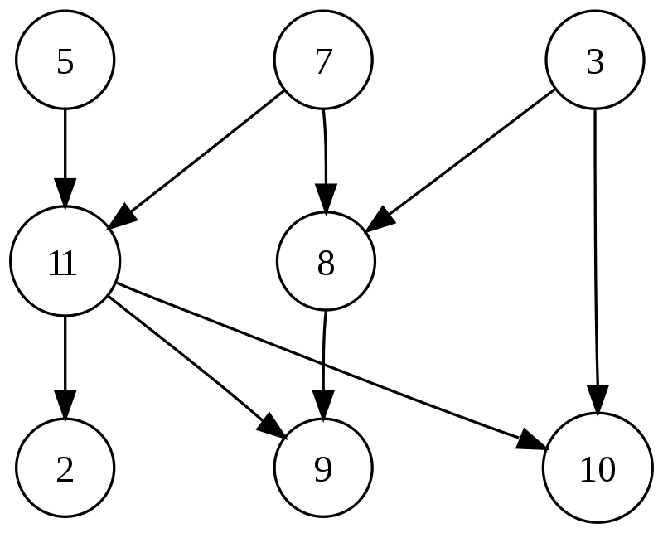
Topological Sorting
Topological sorting for Directed Acyclic Graph (DAG) is a linear ordering of vertices such that for every directed edge uv, vertex u comes before v in the ordering. Topological Sorting for a graph is not possible if the graph is not a DAG.
The graph shown to the left has many valid topological sorts, including:
5, 7, 3, 11, 8, 2, 9, 10 (visual top-to-bottom, left-to-right)
3, 5, 7, 8, 11, 2, 9, 10 (smallest-numbered available vertex first)
5, 7, 3, 8, 11, 10, 9, 2 (fewest edges first)
7, 5, 11, 3, 10, 8, 9, 2 (largest-numbered available vertex first)
5, 7, 11, 2, 3, 8, 9, 10 (attempting top-to-bottom, left-to-right)
3, 7, 8, 5, 11, 10, 2, 9 (arbitrary)

Slide 22
Shortest Path - Dijkstra's algorithm
Dijkstra's algorithm allows us to find the shortest path between any two vertices of a graph.
Create a set sptSet (shortest path tree set) that keeps track of vertices included in the shortest-path tree, i.e., whose minimum distance from the source is calculated and finalized. Initially, this set is empty.
Assign a distance value to all vertices in the input graph. Initialize all distance values as INFINITE. Assign the distance value as 0 for the source vertex so that it is picked first.
While sptSet doesn’t include all vertices
Pick a vertex u which is not there in sptSet and has a minimum distance value.
Include u to sptSet.
Then update distance value of all adjacent vertices of u.
To update the distance values, iterate through all adjacent vertices.
For every adjacent vertex v, if the sum of the distance value of u (from source) and weight of edge u-v, is less than the distance value of v, then update the distance value of v.

Slide 23
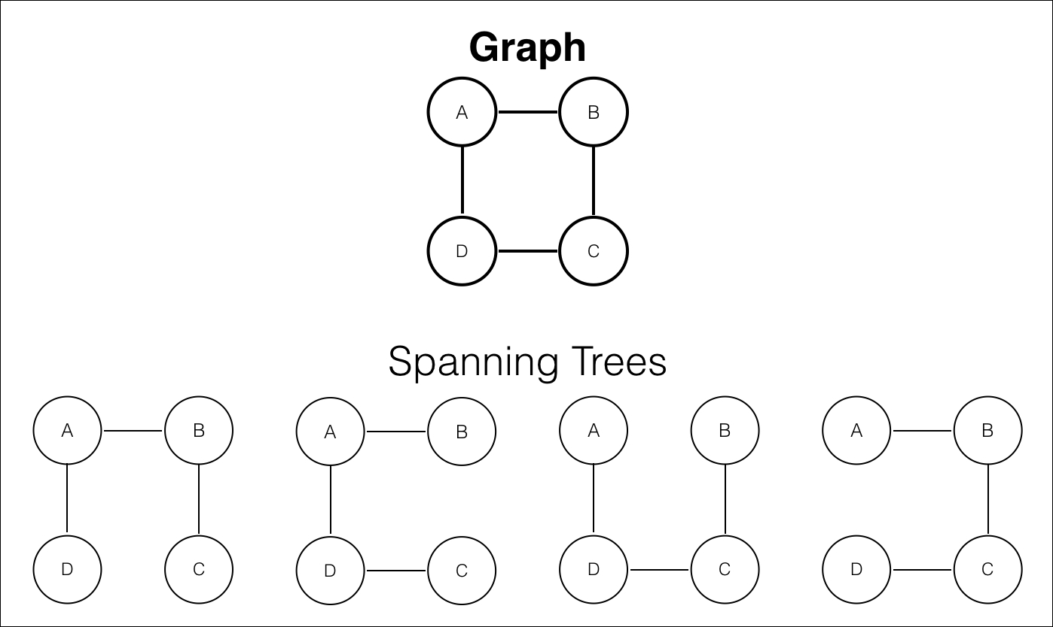
Spanning Tree and Minimum Spanning Tree
A spanning tree is a sub-graph of an undirected connected graph, which includes all the vertices of the graph with a minimum possible number of edges. If a vertex is missed, then it is not a spanning tree. The edges may or may not have weights assigned to them.
A graph has multiple spanning trees.
Minimum Spanning Tree
A minimum spanning tree is a spanning tree in which the sum of the weight of the edges is as minimum as possible.
The minimum spanning tree from a graph is found using the following algorithms:
Prim's Algorithm
Kruskal's Algorithm

Slide 24
Kruskal's Algorithm
Pseudocode
Sort the edges in increasing order of their weights.
Iterate in the sorted edges,
If inclusion of i'th edge leads to a cycle, then skip this edge.
else include the edge in the MST.
Graph
Sorted Edges(w,u,v): {1,5,8}, {1,8,7}, {2,4,3}, {5,1,2}, {5,3,5}, {6,2,3}, {7,6,7}, {9,1,4}, {10,5,6}
Complexity Analysis
Time Complexity: O(E log V)
Space Complexity: O(E+V)

Slide 25
Prim's Algorithm
Prim's technique works on the simple principle that all vertices in a spanning tree must be connected. To build a Spanning Tree, the two distinct subsets of vertices should be joined and they must be connected in such a way that summation of all edge weights is minimum.
Keep track of the vertices included in MST with the set.
Initialize all key values to infinity, and at runtime adjust the first vertex to 0 for selecting it as the tree's initial vertex.
While the Tree Set does not contain all of the vertices:
Choose a vertex x with the smallest edge weight.
Include x in the set.
Update the key value of all adjacent vertices of x.
Complexity Analysis
time complexity of O(V2)
space complexity O(E+V)

Slide 26
Difference between Prim’s and Kruskal’s
Prim’s Algorithm | Kruskal’s Algorithm
It starts to build the Minimum Spanning Tree from any vertex in the graph. | It starts to build the Minimum Spanning Tree from the vertex carrying minimum weight in the graph.
It traverses one node more than one time to get the minimum distance. | It traverses one node only once.
Prim’s algorithm has a time complexity of O(V²), V being the number of vertices and can be improved up to O(E log V) using Fibonacci heaps. | Kruskal’s algorithm’s time complexity is O(E log V), V being the number of vertices.
Prim’s algorithm gives connected component as well as it works only on connected graph. | Kruskal’s algorithm can generate forest(disconnected components) at any instant as well as it can work on disconnected components
Prim’s algorithm runs faster in dense graphs. | Kruskal’s algorithm runs faster in sparse graphs.
It generates the minimum spanning tree starting from the root vertex. | It generates the minimum spanning tree starting from the least weighted edge.
Applications of prim’s algorithm are Travelling Salesman Problem, Network for roads and Rail tracks connecting all the cities etc. | Applications of Kruskal algorithm are LAN connection, TV Network etc.
Prim’s algorithm prefer list data structures. | Kruskal’s algorithm prefer heap data structures.

